Slide 1
Sign language recognition system
Mirjam Nilsson​

Slide 2


CSM-B
A
226Y1A6671
226Y1A6674
226Y1A6699
226Y1A66B7

Slide 3
Introduction
In present world it is very complicated for the deaf & dumb people to talk with the ordinary people, so they requires a translator physically which may not be always convenient to arrange, sign language translator is the appropriate solution that enables deaf/mute people to communicate fluently through technology in different languages.

Slide 4
Method
Implementation: Sensors are connected to Arduino Uno board using during jumper wires. Ones the connections are made perfectly, then Arduino takes inputs from sensors. As the sensors are bent the sensors provides us with an electrical resistance value.

Slide 5
Results
“
The result of the project is to design a smart glove for sign language translation that helps an easy way of communication for speech impaired or hearing-impaired people. Glove need to be equipped with sensors such as flex , accelerometer and touch sensor.
”

Slide 6
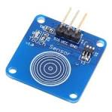
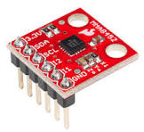
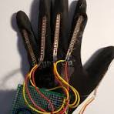
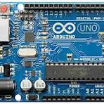
Equipments
Touch sensor​
Accelerometer​
Flex sensor ​
Arduino UNO​
.
.
.
.

Slide 7
Conclusion
In this project , we constructed a Smart-Glove for supporting blind and deaf-blind people in communicating with normal people. The Smart-Glove is able to connect to android mobile and facilitate exchange text messages from and to the Smart-Glove and the Smart-Glove able to send and receive messages from and to the application.

Slide 8
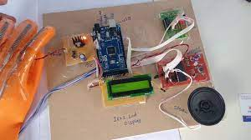
Thank you

